Slide 1
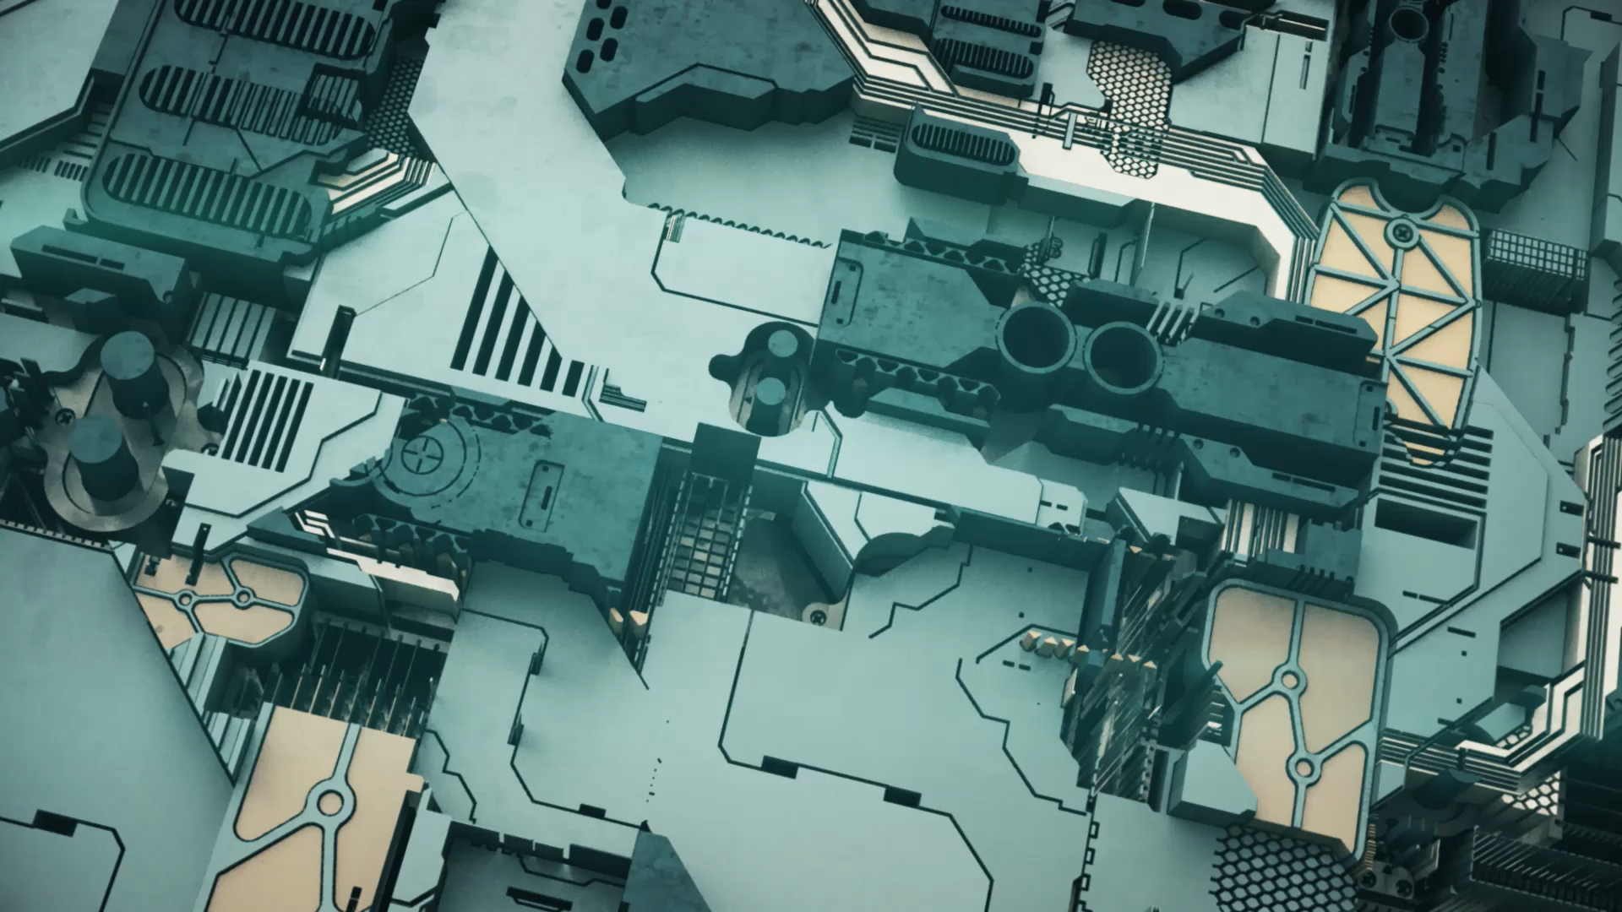
The engine of Modern NLP: The Transformer Architecture
“Attention is all you need”

Slide 2
The Paradigm Shift

Slide 3
The Engine of Modern AI: The Transformer Architecture
https://arxiv.org/abs/1706.03762
From Sequential RNNs to "Attention Is All You Need"

Slide 4
The Bottleneck of RNNs (The "Straw" Problem)
The Problem: Recurrent Neural Networks (RNNs/LSTMs) process data sequentially.
Analogy: It’s like reading a book through a drinking straw. You only see one word at a time, and by the time you reach the end of a long sentence, you’ve forgotten the beginning.
The Vanishing Gradient: Mathematically, the signal from the first word gets weaker as it travels through time.
Imagine: A game of "Telephone" where the message gets distorted at the end of the line

Slide 5
The Solution: Parallelism & Attention
The Transformer Proposal (2017):
Parallelism: Process the entire sentence at the same time. No more steps.
Attention: Instead of relying on memory, look at every other word directly to find context.
Impact: This allowed models to train on the entire internet (Wikipedia, Common Crawl) efficiently

Slide 6
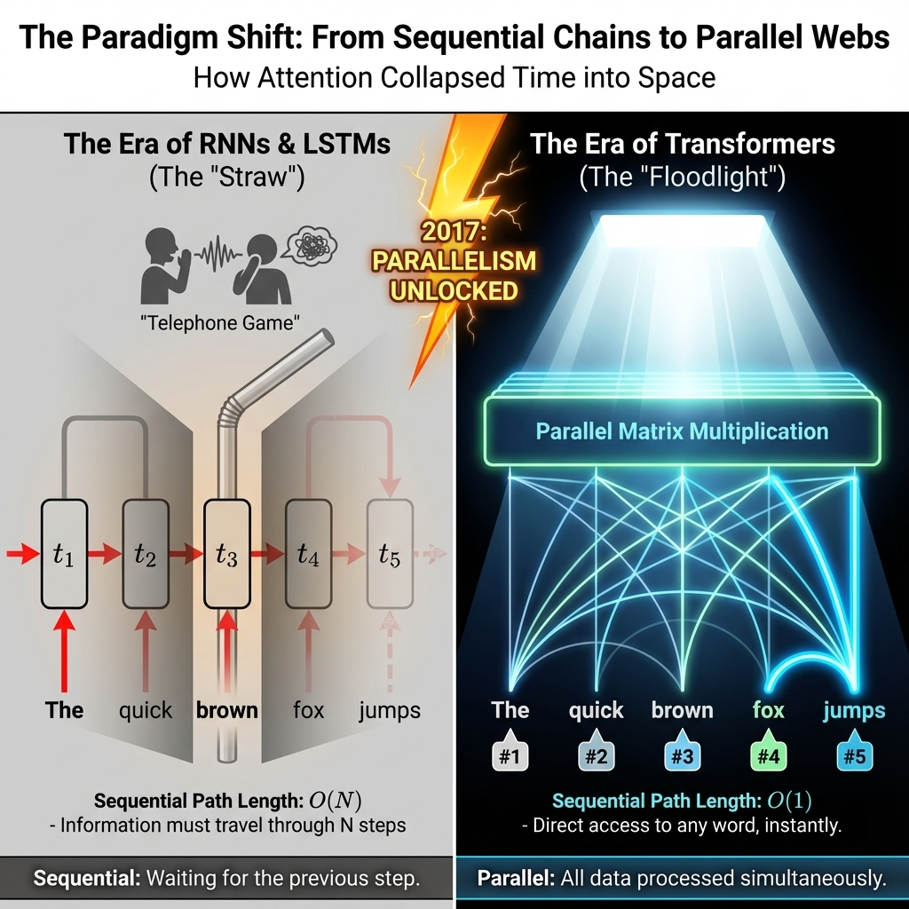
2017 onwards
https://arxiv.org/abs/1706.03762
Notes:
https://arxiv.org/abs/1706.03762 From Sequential RNNs to "Attention Is All You Need“ Key insight: In 2017, we stopped reading like humans (left-to-right) and started reading like computers (parallel matrix operations).

Slide 7
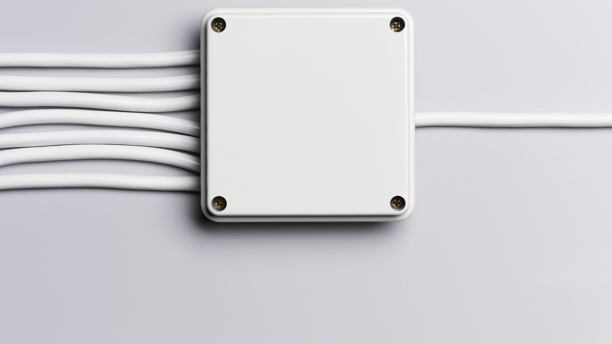
Architectures: Encoder, Decoder & Bidirectional Transformer

Slide 8
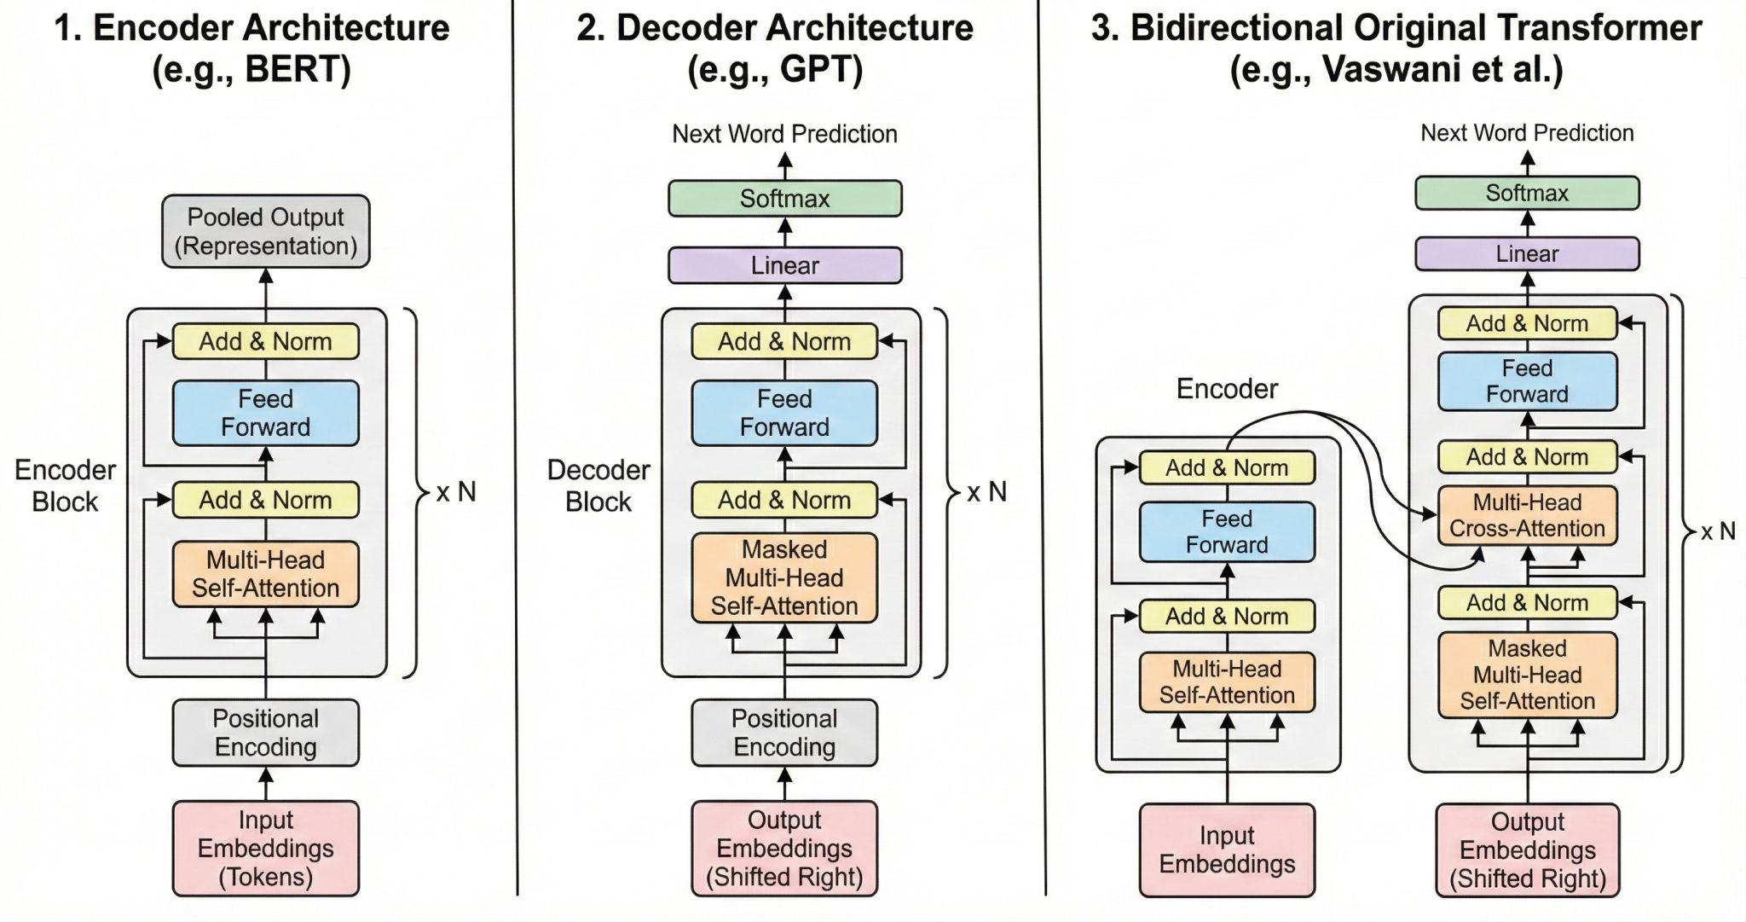
Notes:
How does the new architecture is different and why attention mechanism?
1. Encoder-Only Models (BERT, RoBERTa, DeBERTa) Purpose: Understanding text, not generating it. These models use bidirectional self-attention: Every token can attend to all other tokens, left and right No masking → the model sees the entire input at once Best for: classification, NER, embeddings, sentence understanding Architectural insight: Each encoder layer = multi-head self-attention → feed-forward → normalisation. No cross-attention. No autoregression. The encoder creates a rich semantic graph over the entire input sequence. 2. Decoder-Only Models (GPT, LLaMA) Purpose: Autoregressive generation. These models use causal (masked) self-attention: A token can attend only to tokens before it Future tokens are masked (lower-triangular mask) Ensures no “look-ahead” cheating during generation Architectural insight: Decoder layers = masked self-attention → MLP → next-token prediction. No cross-attention blocks. Think of it as writing a sentence: you only see what you’ve written so far. 3. Encoder–Decoder Models (T5, BART, original Transformer) Purpose: Sequence-to-sequence tasks like translation, summarisation, and Q&A. This architecture combines three attention mechanisms: a) Encoder Self-Attention Bidirectional (like BERT) → deep understanding of the input. b) Decoder Self-Attention Causal (like GPT) → generates step-by-step. c) Cross-Attention (the real differentiator) The decoder queries the encoder’s outputs: Q comes from the decoder K and V come from the encoder This allows the decoder to “look back” at the input while generating. Cross-attention is the key reason seq2seq models excel at translation and summarisation.

Slide 9

Deep Dive into Self-Attention

Slide 10
Self-Attention: The Core Concept
Definition: A mechanism that allows a word to look at other words in the sentence to gather context.
Example: "The animal didn't cross the street because it was too tired."
Question: What does "it" refer to?
Attention: The model builds a strong link between "it" and "animal" and a weak link between "it" and "street."

Slide 11
The Database Analogy (Q, K, V)
This is the most critical concept to teach correctly.
Every word produces three vectors:
Query (Q): What am I looking for? ("I am a pronoun looking for the noun I replace.")
Key (K): What defines me? ("I am a noun, specifically an animal.")
Value (V): What information do I hold? ("I am the vector representation of 'Animal'.")
The Mechanism:
We compare the Query of word A with the Keys of every other word.
High match = High Attention Score.

Slide 12
The "Cocktail Party" Analogy
Scenario: You are at a noisy party.
Q (Your Focus): You are listening for your name or a specific topic (e.g., "Robotics").
K (Voices): Everyone else speaking acts as a "Key".
Score: When someone says "Robotics" (High match between Q and K), you "attend" to them.
V (Content): You absorb the information they are saying.
Read: The Q, K, V matrices – Arpit Bhayani Blog

Slide 13
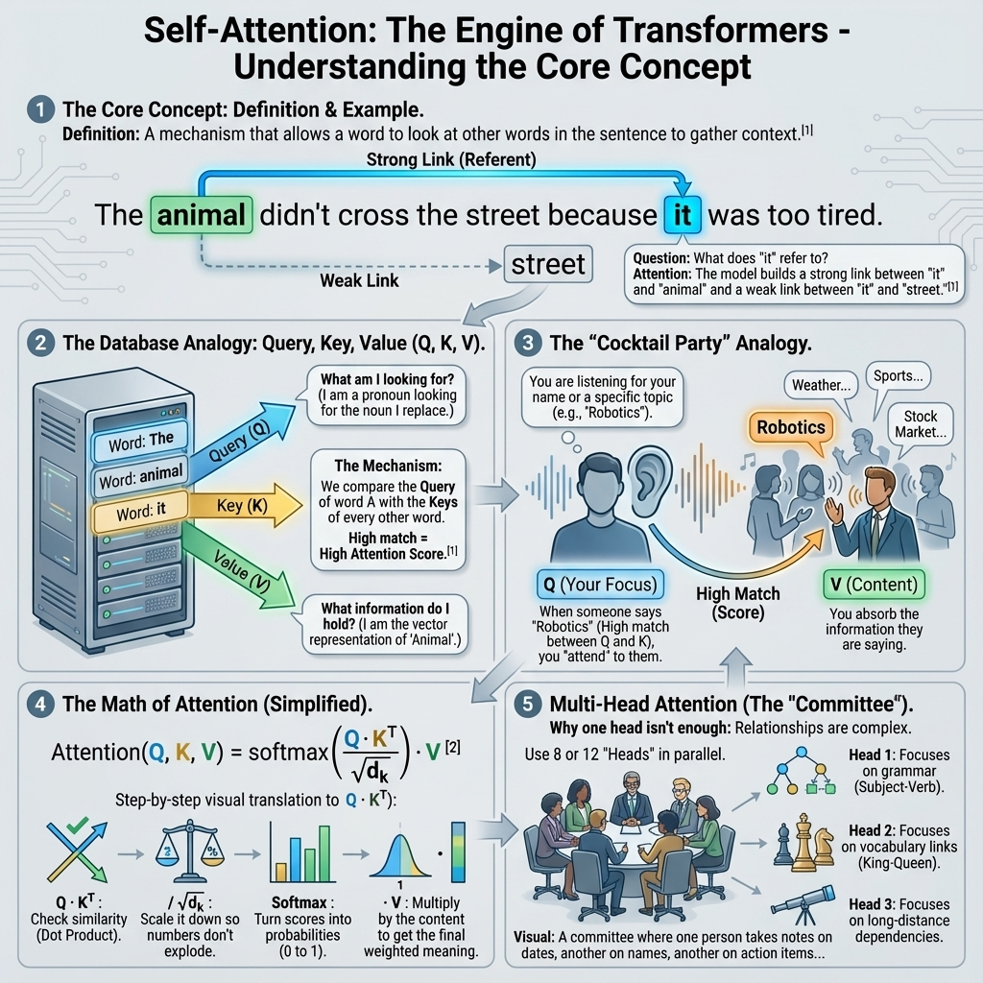
Notes:
Think of a file system or a Hash Map. You have a query, you look up a key, and you get a value. Attention is just a fuzzy Hash Map where you get a mixture of values based on how well the keys match. Read: https://medium.com/@jersy718/the-illustrated-transformer-jay-alammar-in-a-nut-shell-3b5d27225270
The Math (4) and the Multi-head Attention (5)

Slide 14

The Architecture Family

Slide 15
The Transformer Block (The Lego Brick)
Anatomy:
Self-Attention: Finds context.
Layer Norm: Keeps numbers stable (crucial for deep networks).
Feed Forward Network: Processes the information.
Residual Connection: A "highway" that lets data skip layers (prevents signal loss).

Slide 16
Positional Encodings (The Time Stamp)
The Problem: Since transformers look at everything at once, they don't know that "Man bites Dog" is different from "Dog bites Man."
The Fix: We add a "timestamp" vector to every word so the model knows its order in the sequence.

Slide 17
The Family Tree: Encoders vs. Decoders
Encoder-Only (BERT):
Visual: Eyes looking both Left and Right (Bidirectional).
Use: Understanding, Classification, NER. "Fill in the blank."
Decoder-Only (GPT):
Visual: Blinders on the right eye. Can only see what came before (Unidirectional).
Use: Generation, Chat, Writing code. "Predict the next word."
Encoder-Decoder (T5 & BART)
The Hybrid: Uses an Encoder to read the input (e.g., French) and a Decoder to write the output (e.g., English).
Use: Translation, Summarization.

Slide 18
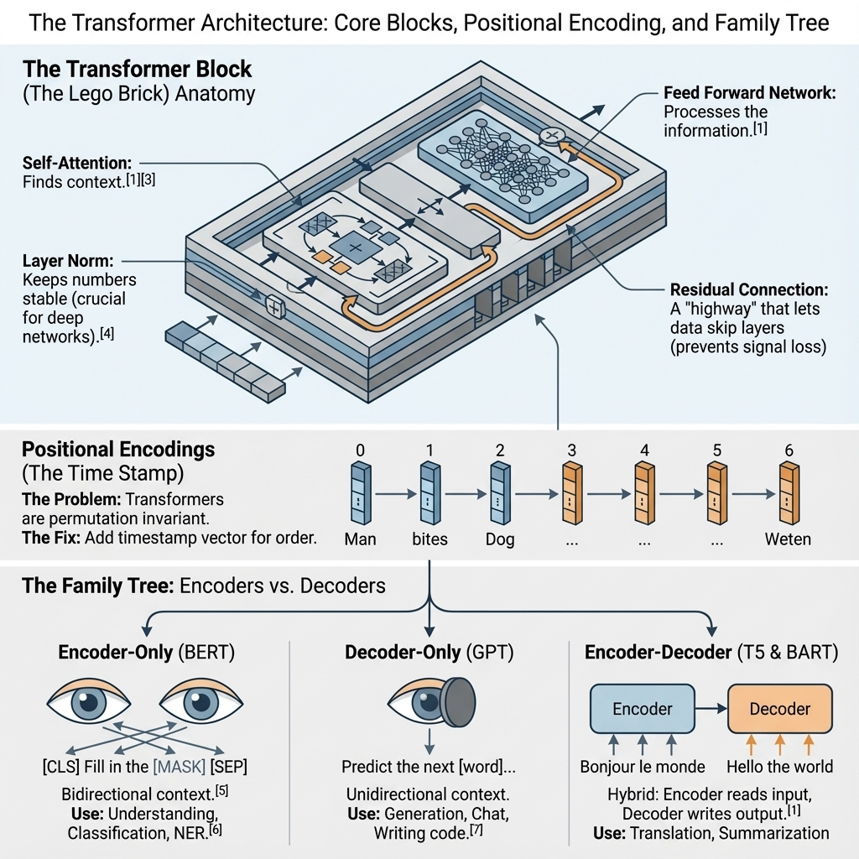
Notes:
Ignore the bracketed numbers as they were part of the original Gemini reference.

Slide 19
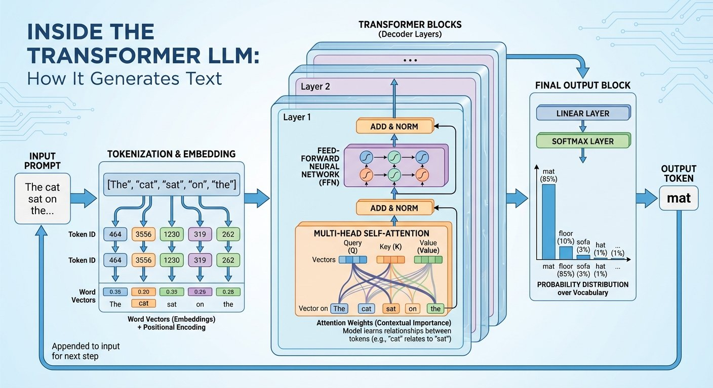
Notes:
Source: https://x.com/NanoBanana/status/1991619646185963938/photo/1

Slide 20
Recommended Readings:
The Gold Standard Visualization: The Illustrated Transformer by Jay Alammar (Essential reading).
Interactive Code: The Annotated Transformer (Harvard NLP) - A line-by-line PyTorch implementation.
Visualization Tool: BertViz GitHub Repository - For the colab: https://colab.research.google.com/drive/1hXIQ77A4TYS4y3UthWF-Ci7V7vVUoxmQ?usp=sharing
Transformer Explainer: https://poloclub.github.io/transformer-explainer/

